Slide 1
Repeated-Measures Designs (GLM 4)
Prof. Andy Field

Slide 2
Aims
Rationale of repeated measures ANOVA
One- and two-way
Benefits
Partitioning variance
Statistical problems with repeated-measures designs
Sphericity
Overcoming these problems
Interpretation

Slide 3
Benefits of Repeated Measures Designs
Sensitivity
Unsystematic variance is reduced.
More sensitive to experimental effects.
Economy
Fewer participants are needed.
But be careful of fatigue.

Slide 4
An Example
Are certain bushtucker foods more revolting than others?
Four foods tasted by eight celebrities:
Stick insect
Kangaroo testicle
Fish eyeball
Witchetty grub
Outcome:
Time to retch (seconds)

Slide 5
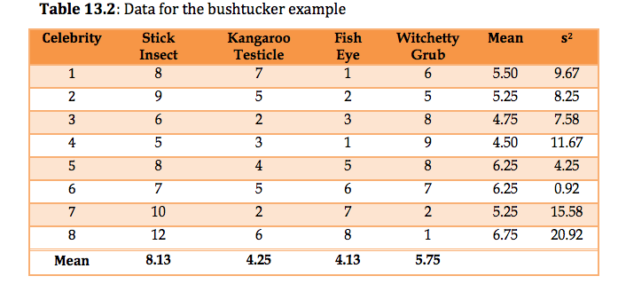
The Data

Slide 6
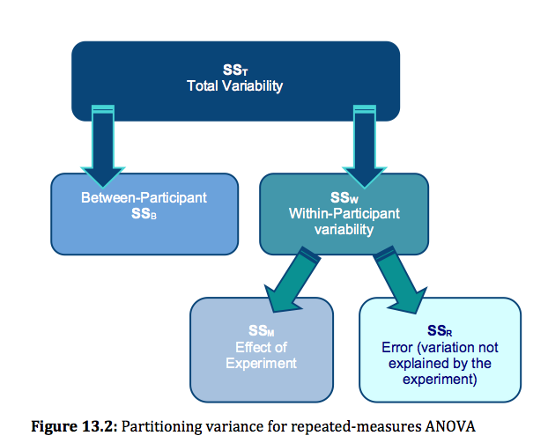

Slide 7
Problems with Analysing Repeated-Measures Designs
Same participants in all conditions
Scores across conditions correlate.
Violates assumption of independence (lecture 2).
Assumption of sphericity
Crudely put: the correlation across conditions should be the same.
Adjust degrees of freedom.

Slide 8
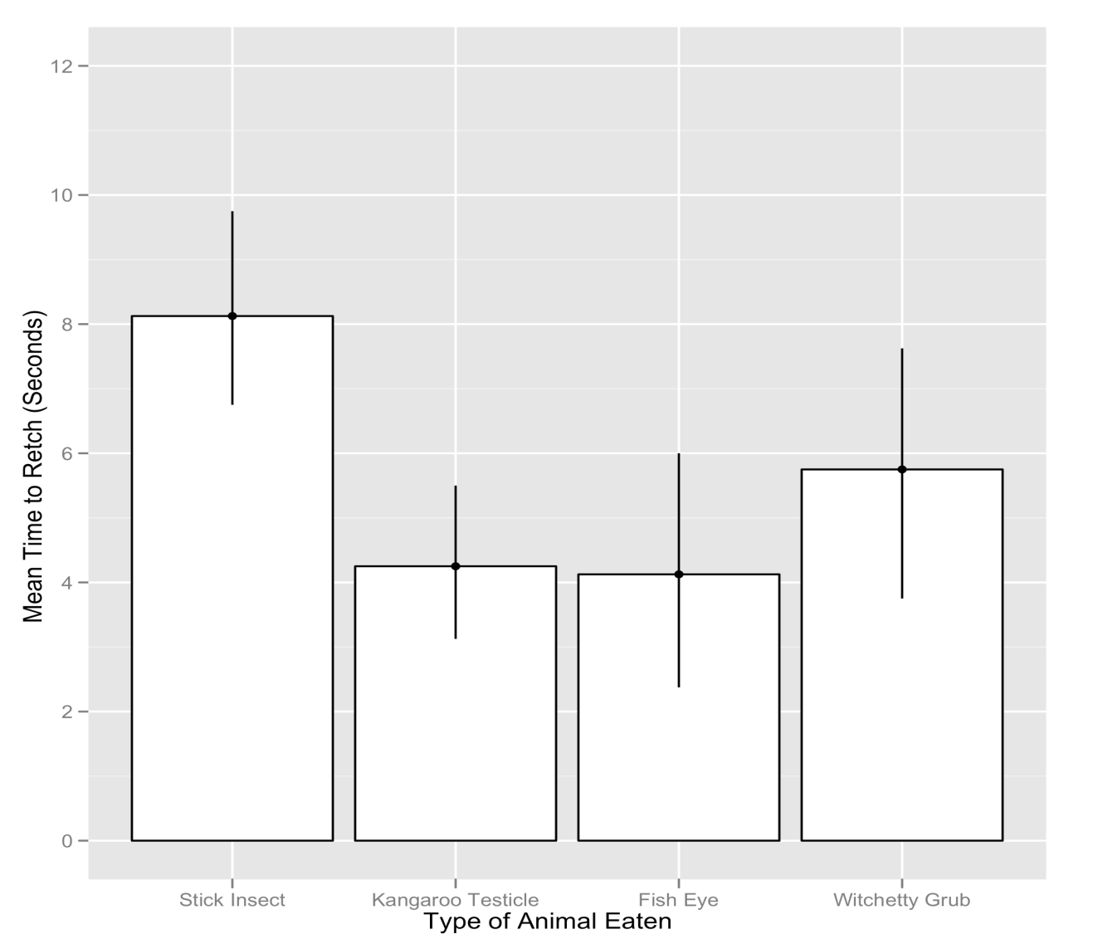
Exploring the Data

Slide 9
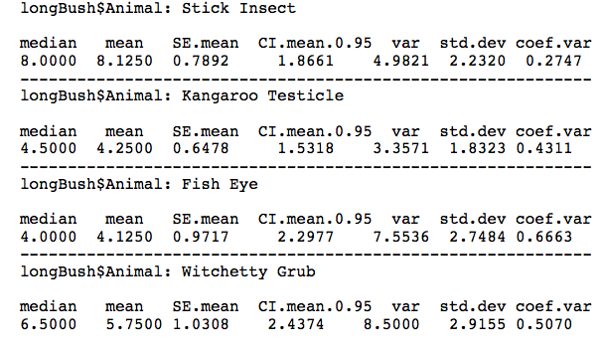
Exploring the Data
by(longBush$Retch, longBush$Animal, stat.desc)

Slide 10
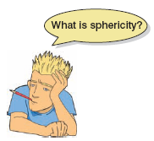
The Assumption of Sphericity
Basically means that the correlation between treatment levels is the same.
Actually, it assumes that variances in the differences between conditions is equal.
Measured using Mauchly’s test.
p < .05, sphericity is violated.
p > .05, sphericity is met.
Notes:
variances.

Slide 11
What is Sphericity?
 | Testicle – Stick | Eye – Stick | Witchetty – Stick | Eye – Testicle | Witchetty – Testicle | Witchetty – Eye
1 | -1 | -7 | -2 | -6 | -1 | 5
2 | -4 | -7 | -4 | -3 | 0 | 3
3 | -4 | -3 | 2 | 1 | 6 | 5
4 | -2 | -4 | 4 | -2 | 6 | 8
5 | -4 | -3 | 0 | 1 | 4 | 3
6 | -2 | -1 | 0 | 1 | 2 | 1
7 | -8 | -3 | -8 | 5 | 0 | -5
8 | -6 | -4 | -11 | 2 | -5 | -7
Variance | 5.27 | 4.29 | 25.70 | 11.55 | 14.29 | 26.55

Slide 12
Estimates of Sphericity
Three measures:
Greenhouse–Geisser estimate
Huynh–Feldt estimate
Lower-bound estimate
Multiply df by these estimates to correct for the effect of sphericity.
G-G is conservative, and H-F liberal.

Slide 13
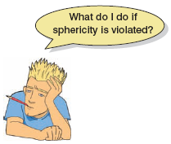
Correcting for Sphericity
df = 3, 21
0.533 = 1.59
0.533 = 11.19
3
21
x
x
0.666 = 13.98
0.666 = 1.99

Slide 14
Choosing Contrasts
PartvsWhole<-c(1, -1, -1, 1)
TesticlevsEye<-c(0, -1, 1, 0)
StickvsGrub<-c(-1, 0, 0, 1)
contrasts(longBush$Animal)<-cbind(PartvsWhole, TesticlevsEye, StickvsGrub)

Slide 15
The Easier (But Slightly Limited) Way: Repeated-Measures ANOVA
bushModel<-ezANOVA(data = longBush, dv = .(Retch), wid = .(Participant), within = .(Animal), detailed = TRUE, type = 3)
To see the output execute the model name:
bushModel

Slide 16
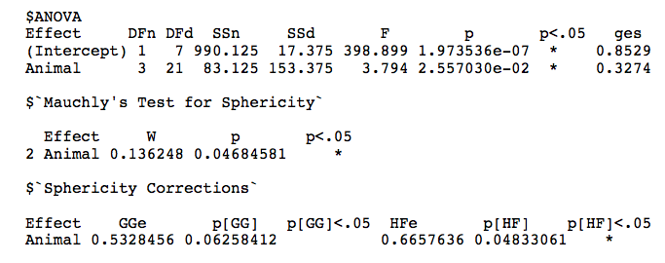
Output

Slide 17
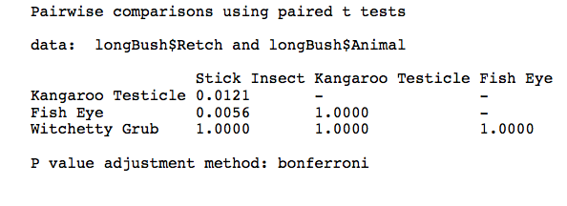
Post Hoc Tests
pairwise.t.test(longBush$Retch, longBush$Animal, paired = TRUE, p.adjust.method = "bonferroni")

Slide 18
The Slightly More Complicated Way: the Multilevel Approach
We can use lme():
bushModel<-lme(Retch ~ Animal, random = ~1|Participant/Animal, data = longBush, method = "ML")
We have defined the model in exactly the same was as for aov(), we have simply added in a term that lets the model know that the variable Animal is made up of the same participants repeated multiple times across the variable Animal:
(random = ~1|Participant/Animal).

Slide 19
The Slightly More Complicated Way: the Multilevel Approach
To test whether Animal had an overall effect, compare the model that we have just created to one in which the predictor is absent:
baseline<-lme(Retch ~ 1, random = ~1|Participant/Animal, data = longBush, method = "ML")
anova(baseline, bushModel)

Slide 20
Parameter Estimates
summary(bushModel)

Slide 21
Post Hoc Tests
To get post hoc tests for the current data, execute:
postHocs<-glht(bushModel, linfct = mcp(Animal = "Tukey"))
summary(postHocs)
confint(postHocs)

Slide 22
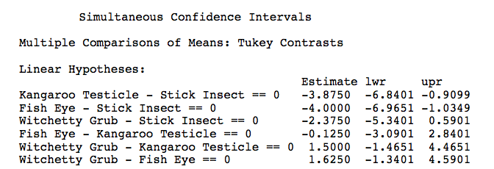
Post Hoc Tests Output

Slide 23
Robust One-Way Repeated-Measures ANOVA
Needs data to be in wide format.
Get rid of participant variable:
bushData2<-bushData[, -c(1)]

Slide 24
Robust One-Way Repeated-Measures ANOVA
rmanova(bushData2)
or:
rmanovab(bushData2, nboot = 2000)

Slide 25
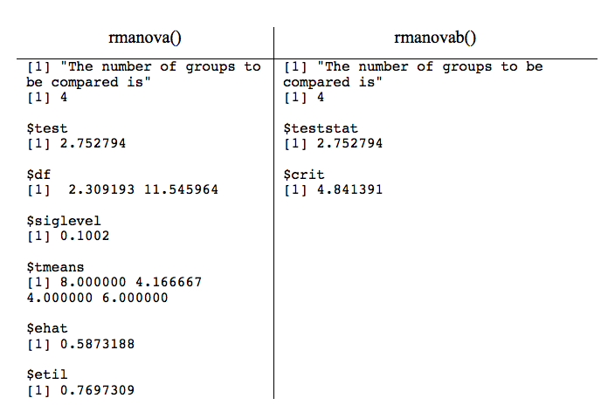
Output

Slide 26
What is Two-Way Repeated-Measures ANOVA?
Two independent variables
Two-way = 2 IVs
Three-way = 3 IVs
The same participants in all conditions
Repeated measures = ‘same participants’
A.k.a. ‘within-subjects’

Slide 27
An Example
Field (2009): Effects of advertising on evaluations of different drink types.
IV 1 (Drink): beer, wine, water
IV 2 (Imagery): positive, negative, neutral
Dependent variable (DV): Evaluation of product, from –100, dislike very much, to +100, like very much

Slide 28
SS_{T}
Variance between all participants
SS_{M}
Within-Participant Variance Variance explained by the experimental manipulations
SS_{R}
Between-Participant Variance
SS_{A}
Effect of Drink
SS_{B}
Effect of Imagery
SS_{A × B}
Effect of Interaction
SS_{RA}
Error for Drink
SS_{RB}
Error for Imagery
SS_{RA × B}
Error for Interaction

Slide 29
Getting Data into the Correct Format
Data needs to be in long format.
Can use melt() function to change data into long format:
longAttitude <-melt(attitudeData, id = "participant", measured = c( "beerpos", "beerneg", "beerneut", "winepos", "wineneg", "wineneut", "waterpos", "waterneg", "waterneu"))
Rename columns so that we actually know what they represent by executing:
names(longAttitude)<-c("participant", "groups", "attitude")

Slide 30
Getting Data into the Correct Format for the Analysis
The variable groups is a mixture of our two predictor variables (imagery and type of drink).
We need to create two variables that dissociate the type of imagery from the type of drink:
longAttitude$drink<-gl(3, 60, labels = c("Beer", "Wine", "Water"))
We also need a variable that tells us the type of imagery that was used:
longAttitude$imagery<-gl(3, 20, 180, labels = c("Positive", "Negative", "Neutral"))

Slide 31
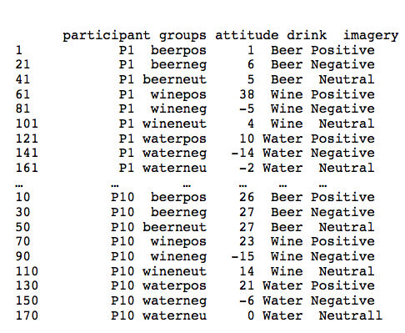
Getting Data into the Correct Format for the Analysis

Slide 32
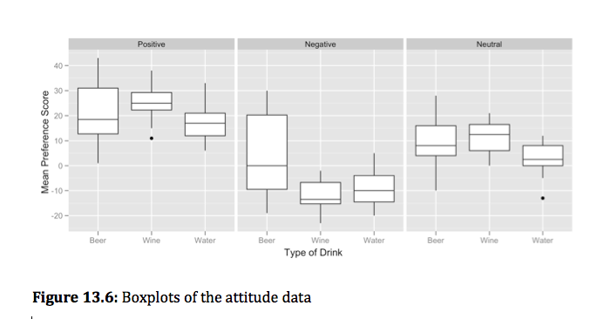
Exploring Data

Slide 33
Setting Contrasts

Slide 34
Factorial Repeated-Measures ANOVA
attitudeModel<-ezANOVA(data = longAttitude, dv = .(attitude), wid = .(participant), within = .(imagery, drink), type = 3, detailed = TRUE)
attitudeModel

Slide 35
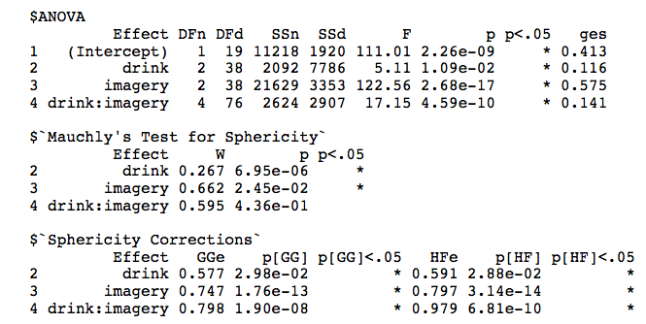
Output

Slide 36
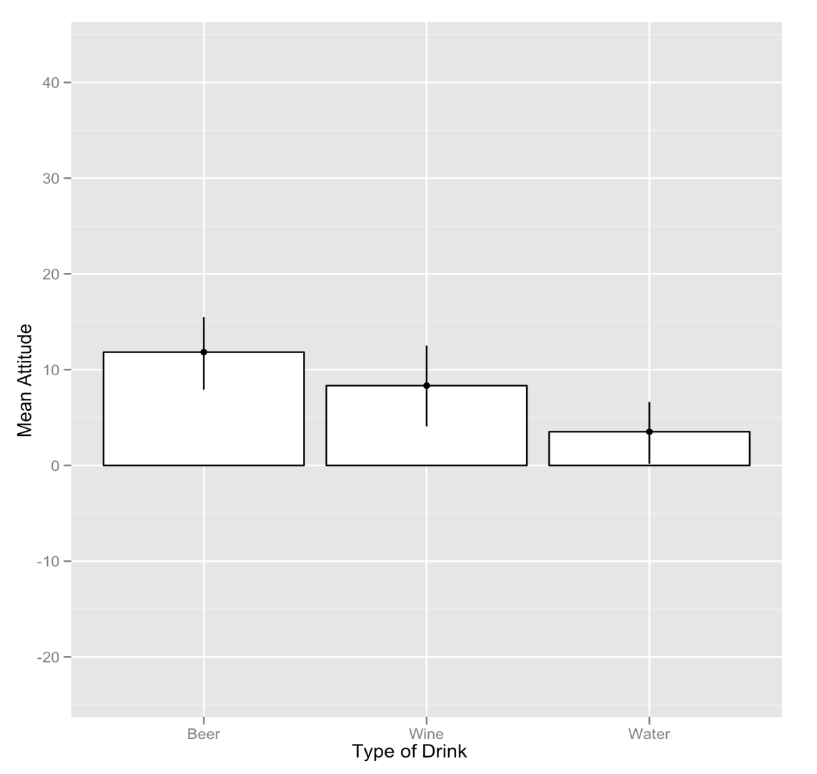
Main Effect of Drink
F(2, 38) = 5.11, p < .05

Slide 37
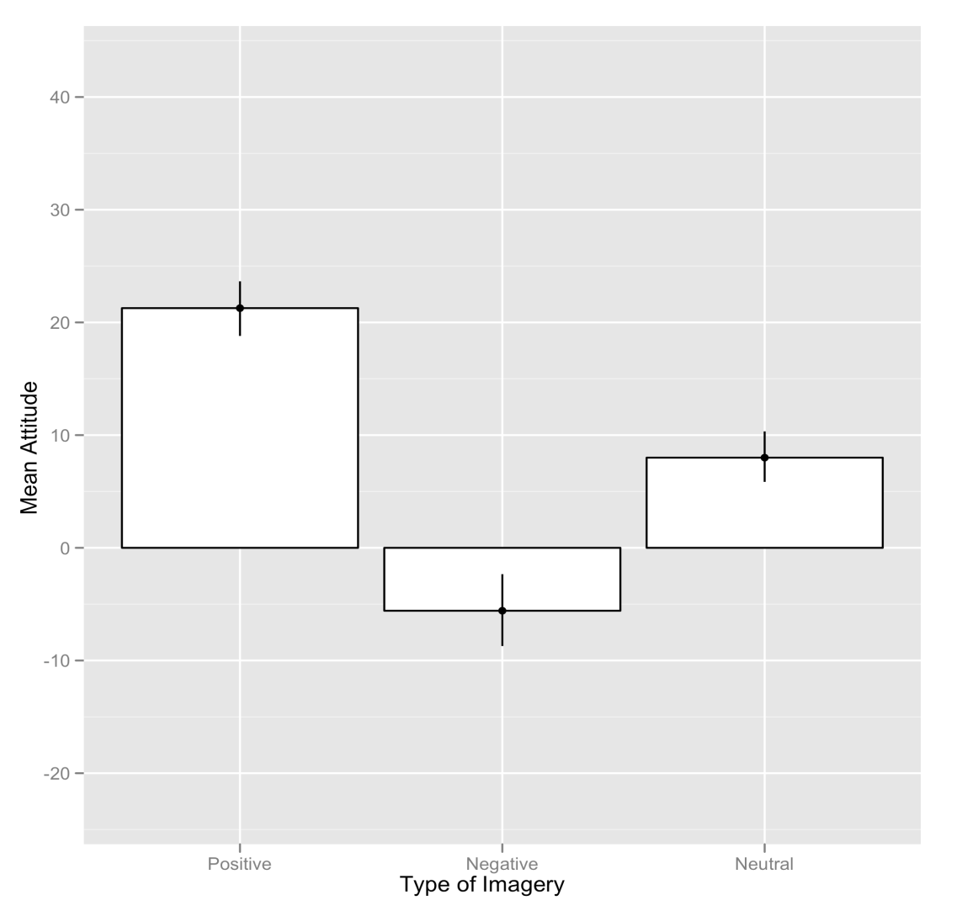
Main Effect of Imagery
F(2, 38) = 122.56, p < .001

Slide 38
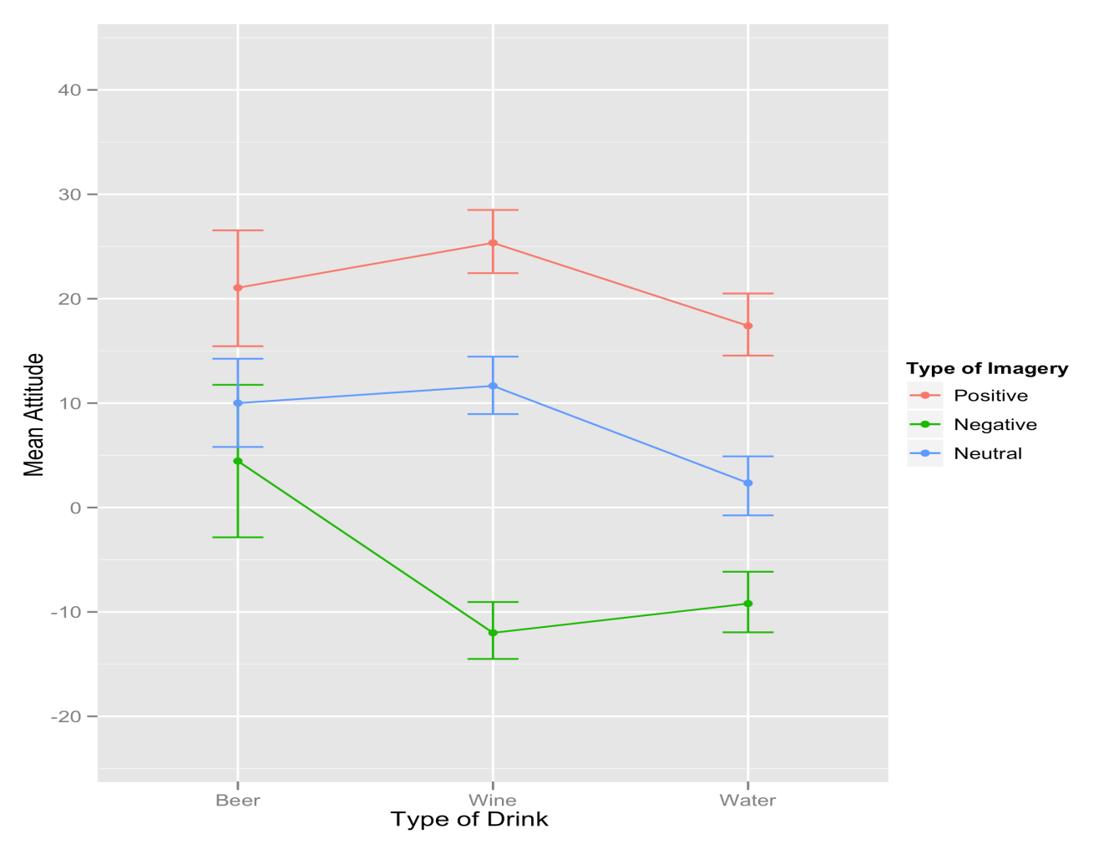
The Interaction Effect (drink × imagery)
F(4, 76) = 17.15, p < .001

Slide 39
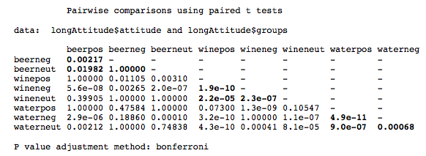
Post Hoc Tests for the Interaction Term
pairwise.t.test(longAttitude$attitude, longAttitude$groups, paired = TRUE, p.adjust.method = "bonferroni")

Slide 40
Factorial Repeated-Measures Designs as a GLM
baseline<-lme(attitude ~ 1, random = ~1|participant/drink/imagery, data = longAttitude, method = "ML")
If we want to see the overall effect of each predictor then we need to add them one at a time:
drinkModel<-update(baseline, .~. + drink)
imageryModel<-update(drinkModel, .~. + imagery)
attitudeModel<-update(imageryModel, .~. + drink:imagery)

Slide 41
Factorial Repeated-Measures Designs as a GLM
To compare these models we can list them in the order in which we want them compared in the anova() function:
anova(baseline, drinkModel, imageryModel, attitudeModel)

Slide 42
Parameter Estimates
We can further explore the model by executing:
summary(attitudeModel)
Most important, these include the parameters for the contrasts that we set for each variable.

Slide 43
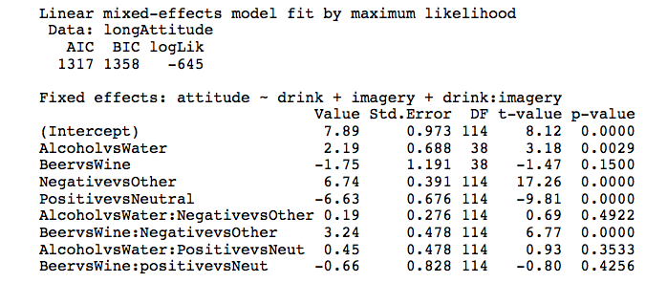
Parameter Estimates

Slide 44
